Slide 1


NAME
Title
Notes:
In

Slide 2

GET TO KNOW THE PLANNER
General and very high-level description of what you do as a planner:
  Project types you have been involved in (possibly avoid mentioning any specific projects that could be politically charged discussion points)
  Types of people you interact with on a daily basis
  What you enjoy best about being a planner
What attracted you to planning?
How did you get into planning?
Notes:
Replace Planner image on right with your profession photo or one of you working in the community.

Slide 3
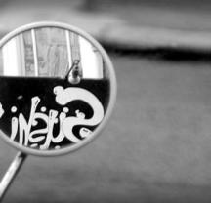




ASK
QUESTIONS
RULES OF
THE ROAD
PAY
ATTENTION
HAVE
FUN!
BE RESPECTFUL
& PROFESSIONAL
BE CREATIVE!
PARTICIPATE

Slide 4
THE ELEMENTS OF A COMMUNITY

Slide 5
Places with nothing on them at all.
Places where things are made/refined, etc.
Where things are grown or raised.
Places where people live.
Places where people buy things.
Places where community activities take place or community resources are stored.

Slide 6
BUILDING THE COMMUNITY
Notes:
Include graphic of local Land Use Map before presenting.

Slide 7
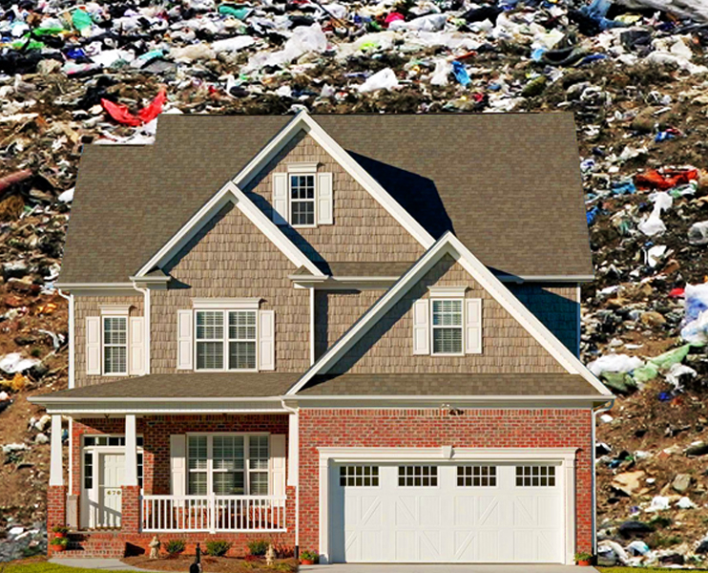

RESIDENTAL GARBAGE FIASCO

Slide 8
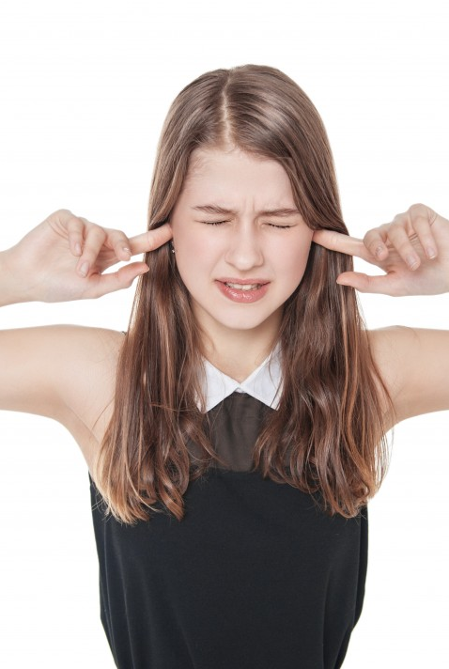
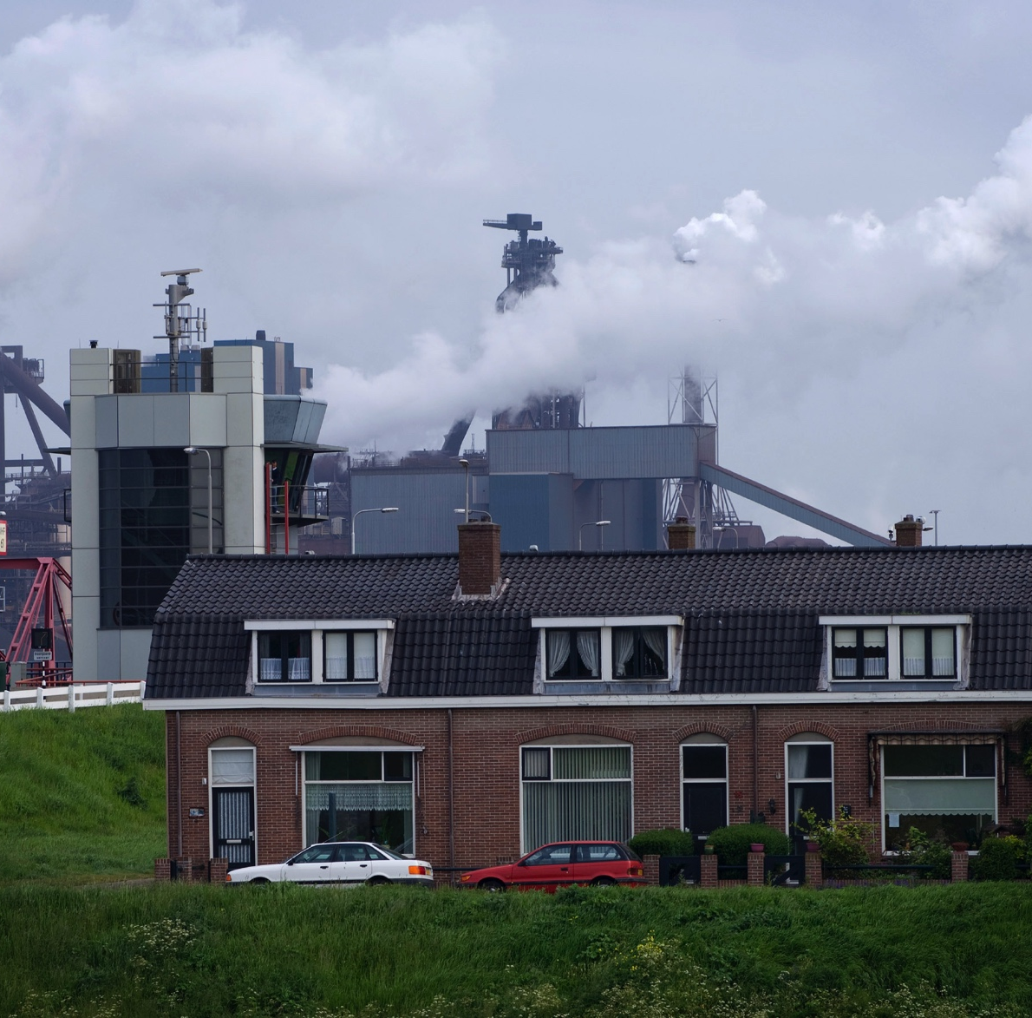
RESIDENTAL NOISE FIASCO

Slide 9
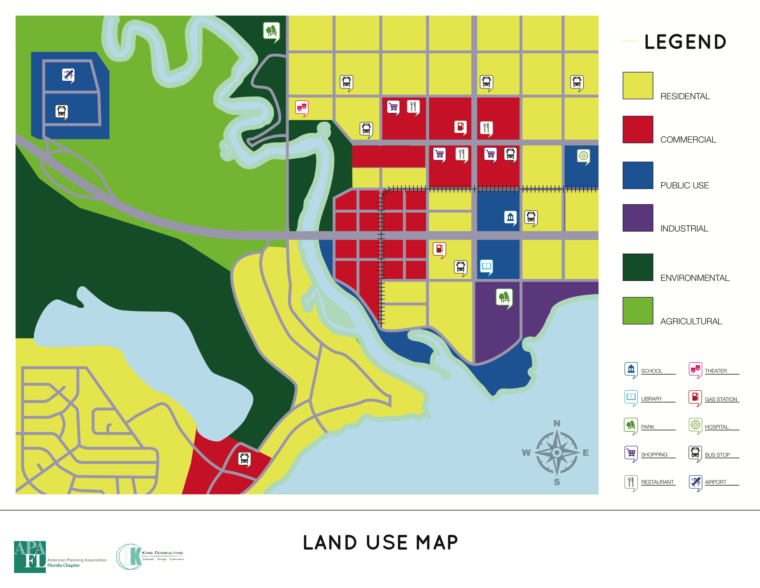

Slide 10
Places with nothing on them at all.
Places where things are made/refined, etc.
Where things are grown or raised.
Places where people live.
Places where people buy things.
Places where community activities take place or community resources are stored.

Slide 11

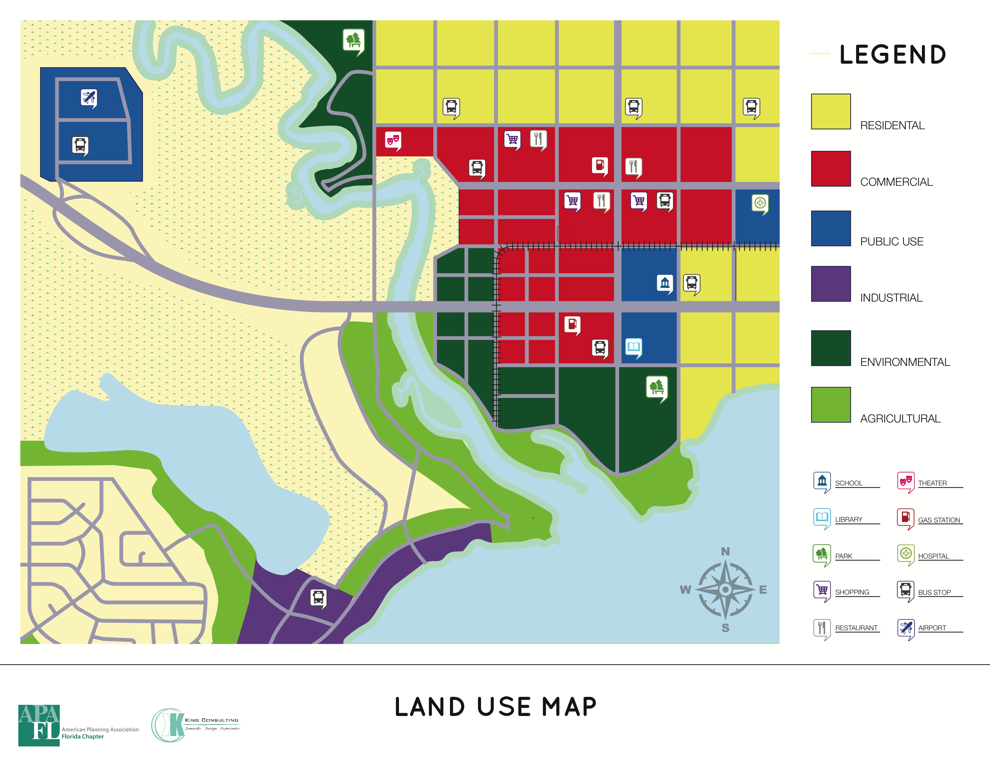
BUILDING THE COMMUNITY
10-12 minutes
Use all of the categories.
Think about why you are putting types of things next to each other.
Use at least 3 different icons.
Notes:
Think about why you are putting types of things next to each other:
“Why would it be a good or bad idea to have each type next to or far away from your home?”
“What kinds of things do you wish were closer to your home?”
“What kinds of things do you wish were easier to get to from your school/home/etc.?”
“What kinds of things do you wish that there were more of in your part of town?”

Slide 12
PRESENT YOUR COMMUNITY
Where would you live?
Where would your school be?
What would be your favorite thing to do?
  How easy would it be to get to from your home or school?
Where would your family work?
What’s unique in your community?
How would you get around town?
  Car, bus, train, something else?

Slide 13
POP QUIZ
How many land use categories are there?
What did we do with our land use chart? What about with our maps?
What are some things that we thought about while planning our communities?
  What kinds of things are good to have close to each other?
  What are some things that should be kept further apart?
What did you like best about today?
What did you learn that you will tell your parents?
Would anyone like to be a planner when they grow up? Why?
Notes:
This is an **Optional Closing Discussion**

Slide 14
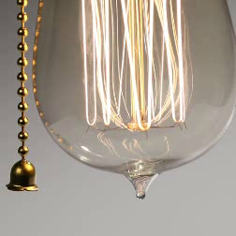
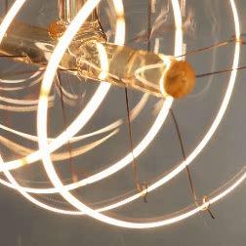


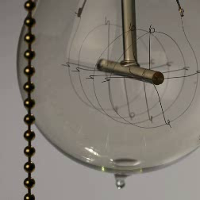
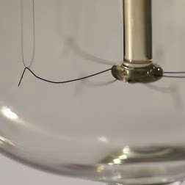
Questions

Slide 15

THANK YOU!
NAME
Title
Email
Website (optional)

