Slide 1
v
NAME
Title

Slide 2
Get to Know a Planner
YOUR NAME
TITLE
DEGREE
Project types you have been involved in (possibly avoid mentioning any specific projects that could be politically charged discussion points)

Slide 3
Get to Know a Planner
Types of people you interact with on a daily basis
What you enjoy best about being a planner
What attracted you to planning?
What attracted you to planning?
How did you get into planning?
What has your career looked like?

Slide 4
What are the types of planners?
There are many different kinds of planners:
Community planners build consensus in the community on how it should grow, and how each piece of land around a city should be used.
Environmental planners make sure that important natural features of a community are protected.
Transportation planners plan a city's transportation system: roads and highways, railroads, bike paths, and sidewalks.
Other: affordable housing, economic development, and historic preservation.

Slide 5
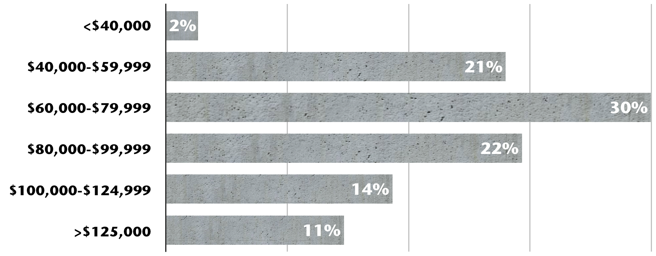
What could I earn as a planner?
Median
$77,300

Slide 6
What does it take to be a planner?
Whether specialists or generalists, most planners share a common set of skills:
involve all affected parties in important planning decisions;
help communities to develop their own vision of the future, preparing plans responsive to shared community objectives;
analyze qualitative and quantitative information to suggest possible solutions to complex problems;
evaluate the cost-effectiveness of proposed projects and plans;
and present recommendations to public officials and citizen groups in a comprehensive and understandable way.

Slide 7
Agenda
Introduction
Key to the Community
As the Planner Sees It: Role Play
Future in the Planning Process
Wrap-up.

Slide 8
Rules of the road
Expectations
Ask questions.
Pay attention.
Participate.
Be respectful and professional towards other students.
Be creative!
Have fun!

Slide 9
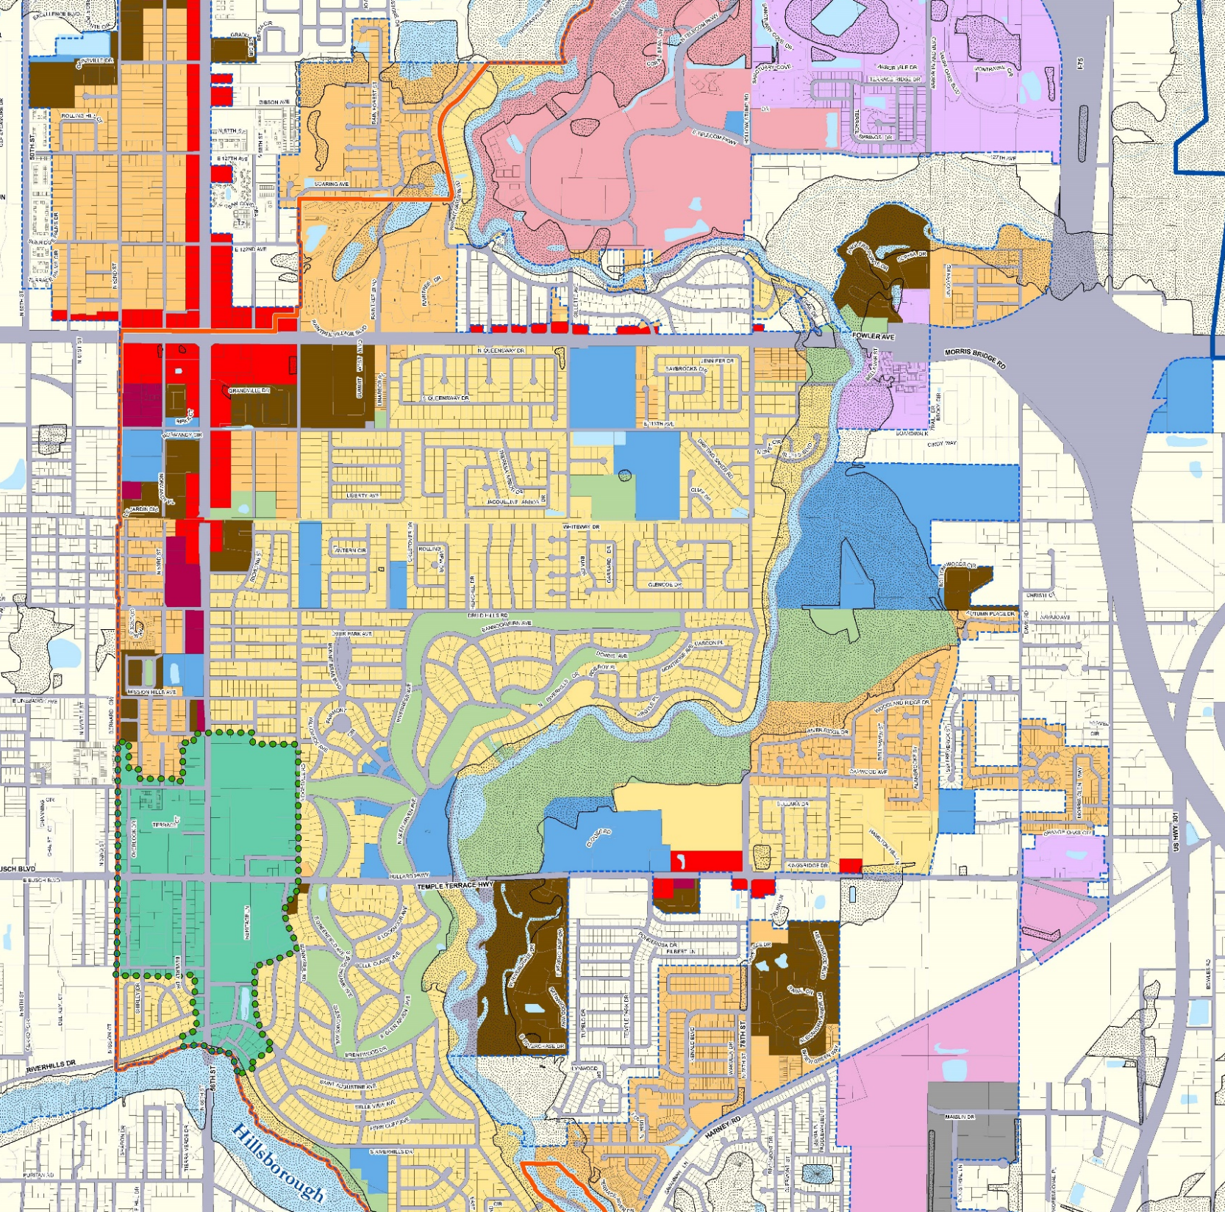
KEY TO THE COMMUNITY

Slide 10
Land Use Maps
How do you think maps are used in community planning?
Decide where businesses go
Decide what businesses go where
Decide where nature preserves and parks go
Plan transportation
Decide where public services can go

Slide 11
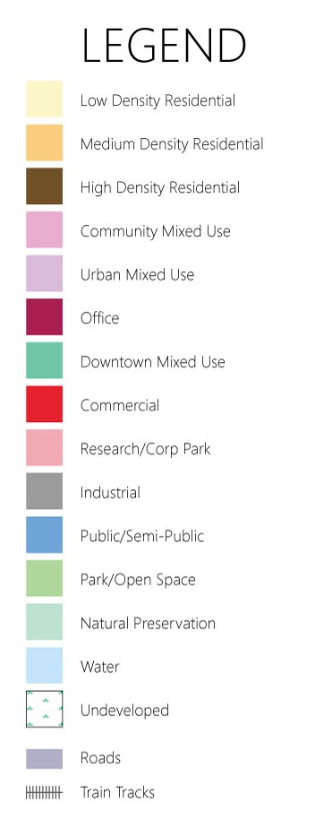
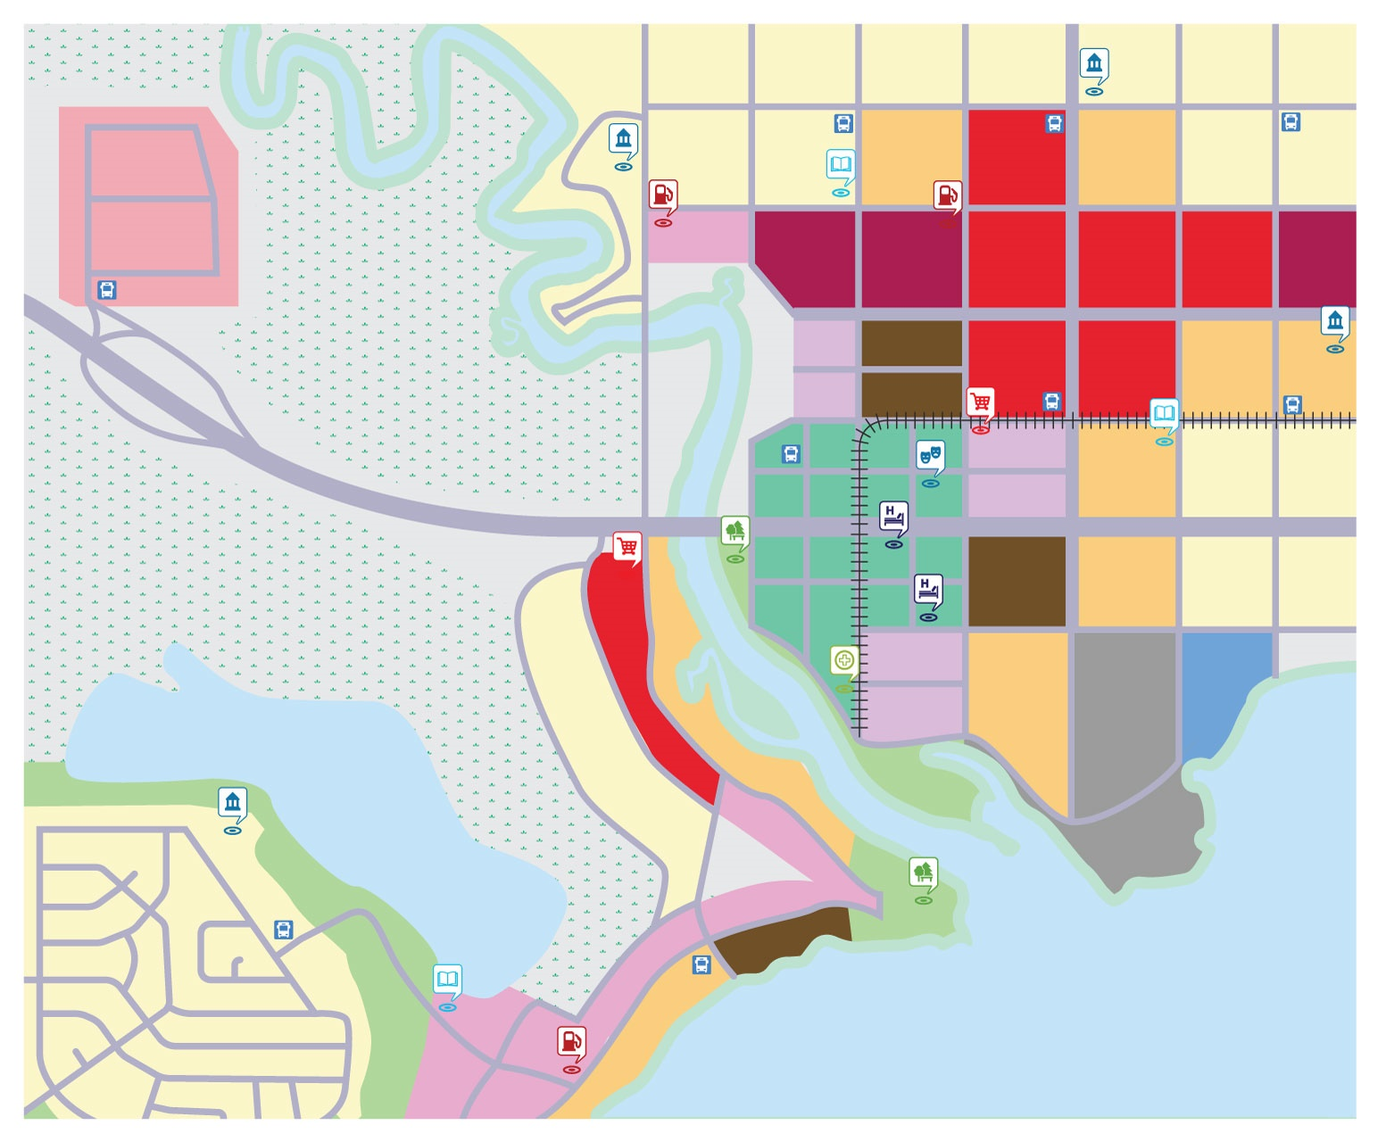
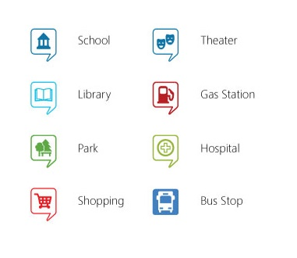

Slide 13
Planning
Behind the Map
Why do you think each community element would be so far from or central to others?
Are there any features of the way that the map is laid out that you recognize from your community?
Thinking of your community, what are some reasons that things like highways run through different types of areas (e.g. commercial, residential, etc.)?

Slide 14
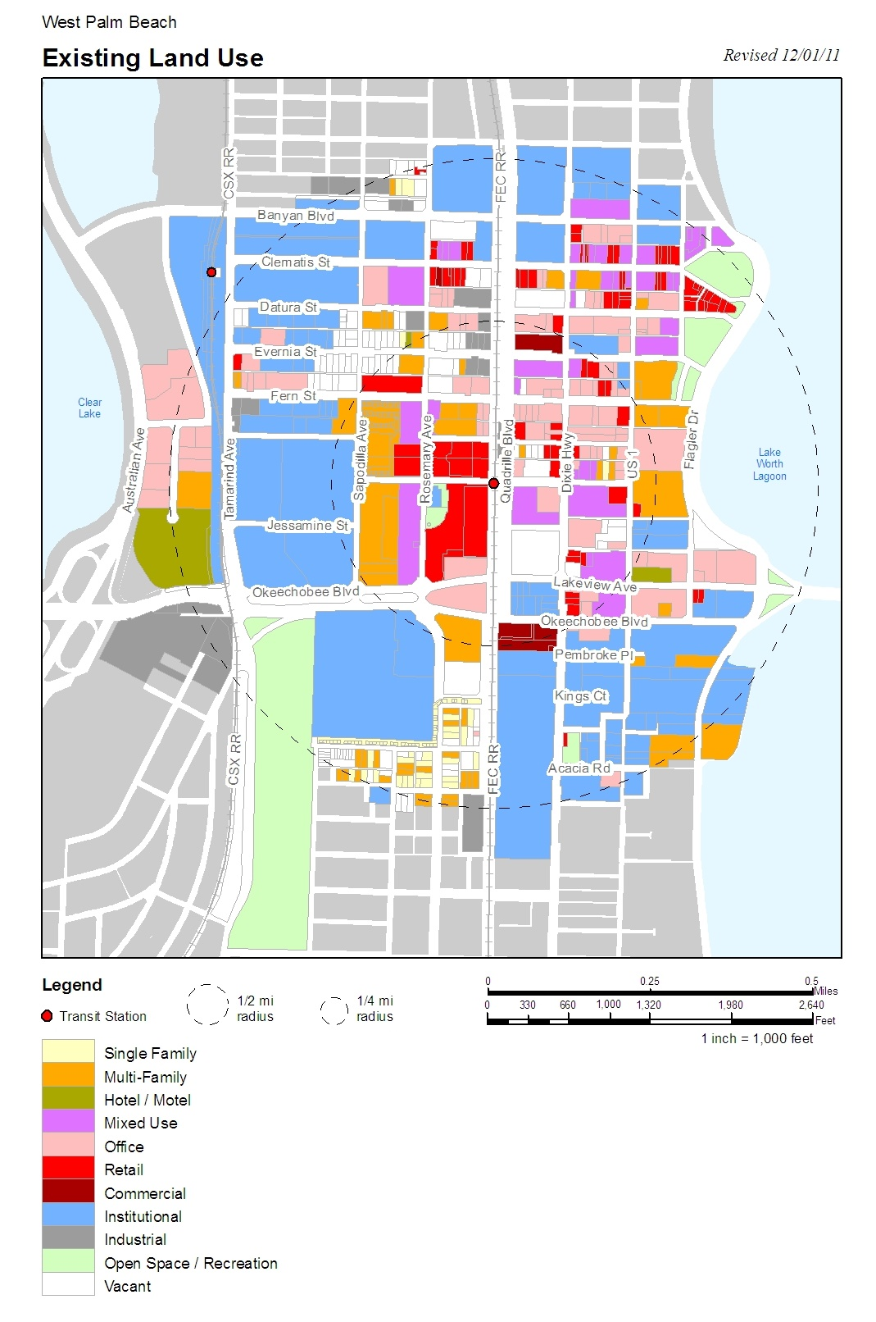
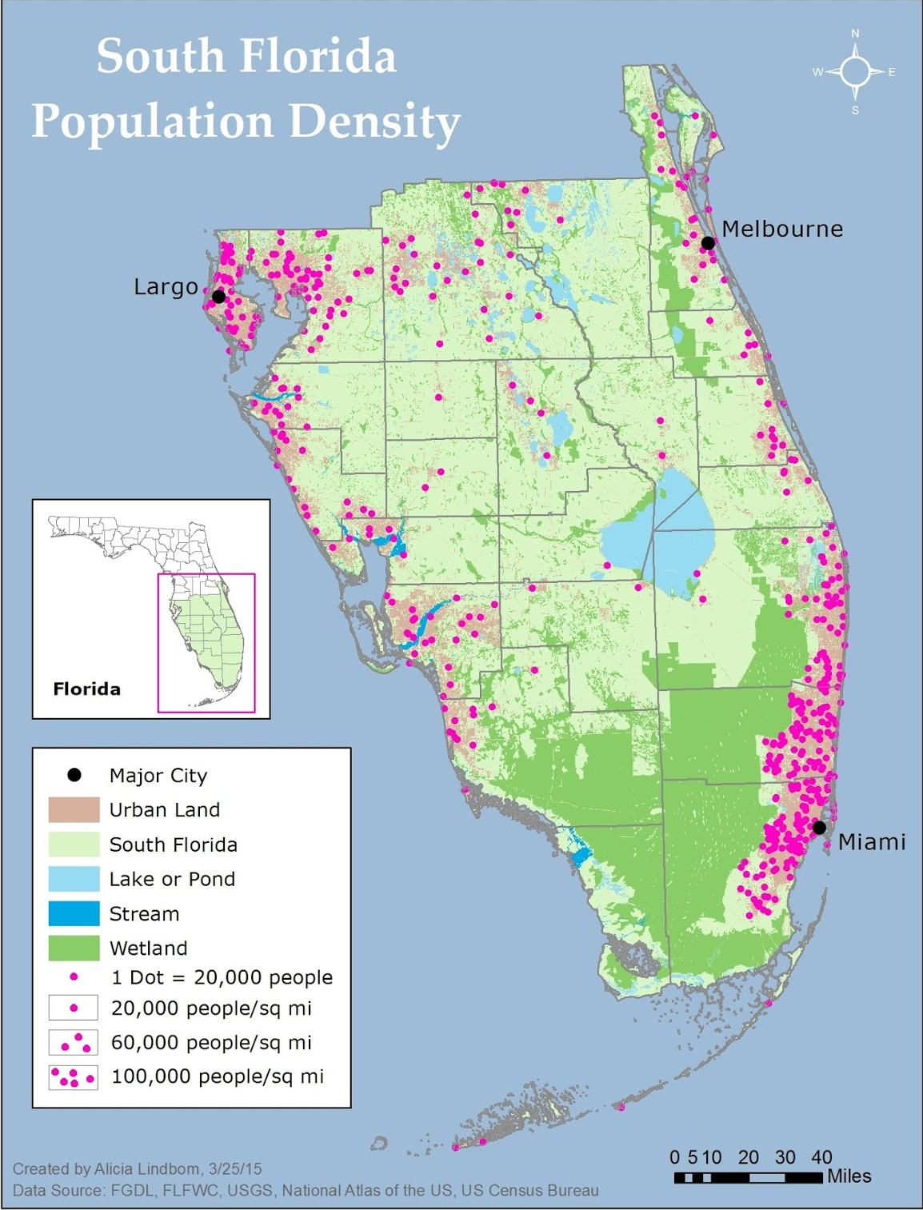
Notes:
SAMPLE MAP SECTION

Slide 15
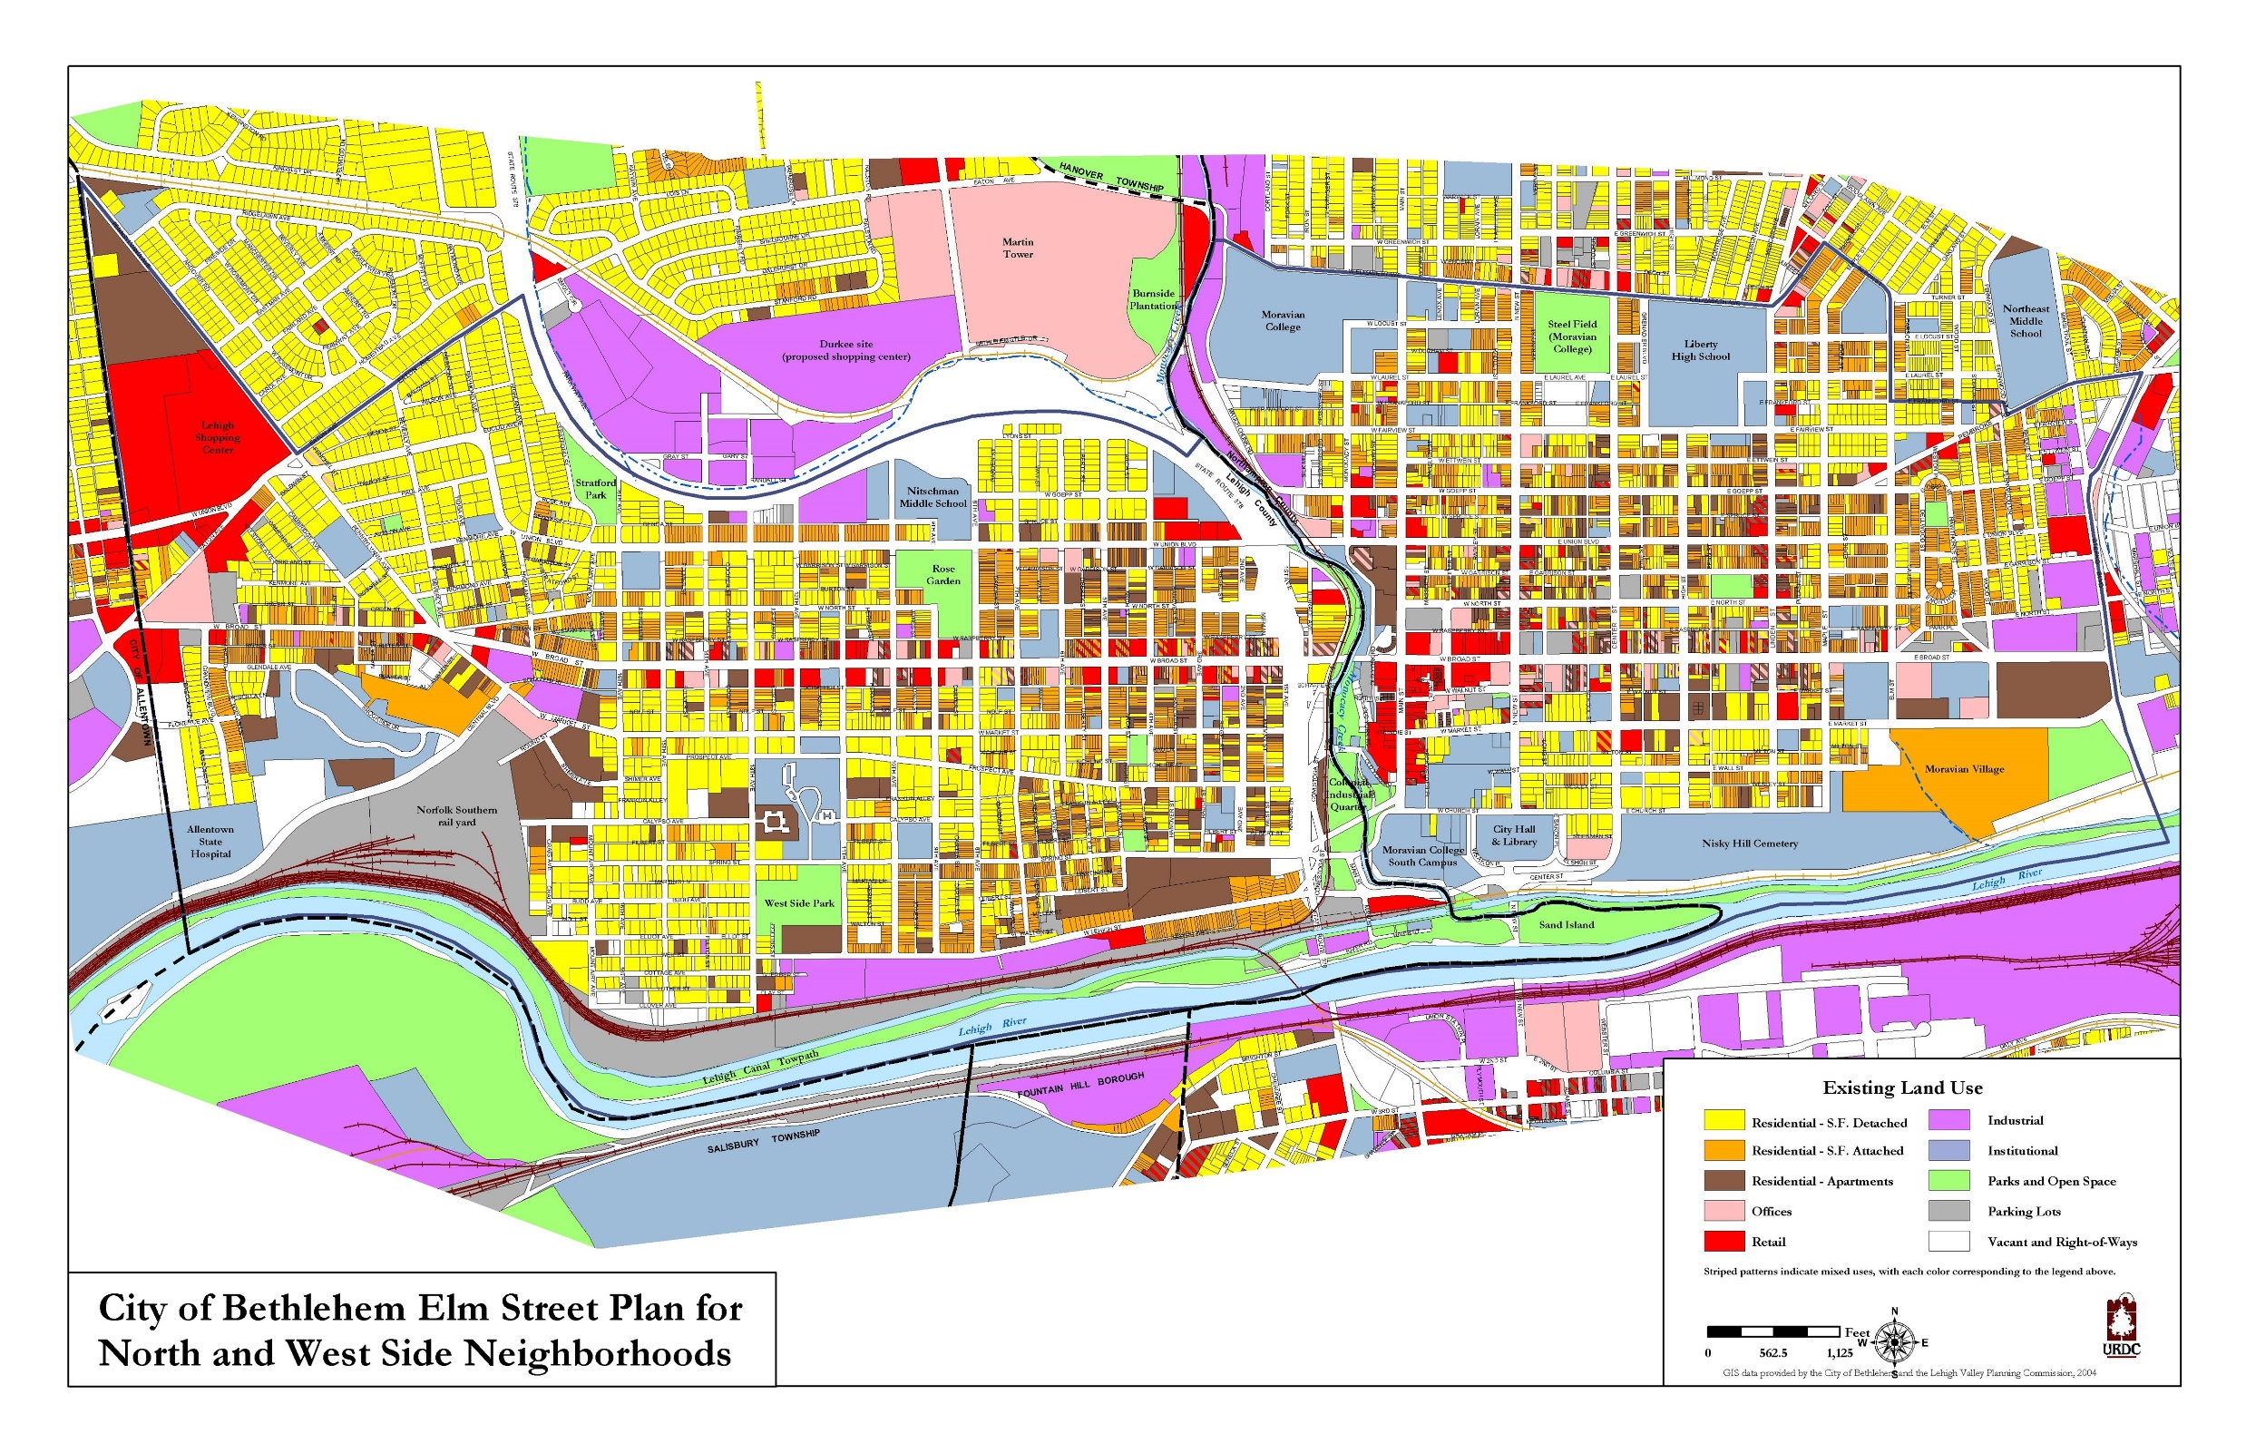
Notes:
SAMPLE MAP SECTION

Slide 16
AS THE PLANNER SEES IT

Slide 17
Population Distribution Maps
Notes:
REPLACE MAP
These maps show concentrations of population density that can aid in decisions about infrastructure and things like highways to connect residents with areas of higher job concentration.

Slide 18
Land Use Maps
Notes:
REPLACE MAP
We have already discussed these and have an idea of how they’re used in planning to help prevent things like urban sprawl.

Slide 19
Aerial Maps
Notes:
REPLACE MAP
Help planners determine what’s on the ground and the surrounding uses.

Slide 20
Demographic Data
Notes:
REPLACE IMAGE WITH DATA
Common demographic data we use is population projections, ages, ethnicity, income, travel patterns, employment in specific industries.
Population projections are the most important as they help us plan where and how communities will grow (or shrink) over the next decade or two. Help us plan for where to locate homes, schools, parks, roads, transit, etc.

Slide 21
Surveys
Notes:
REPLACE IMAGE WITH SURVEY DATA
There are many types of surveys and formats for their distribution. They pose simple questions to gather data that can be used to indicate needs, opinions, and even evaluate. They can be used, for example, in deciding whether a community is willing to finance a project.

Slide 22
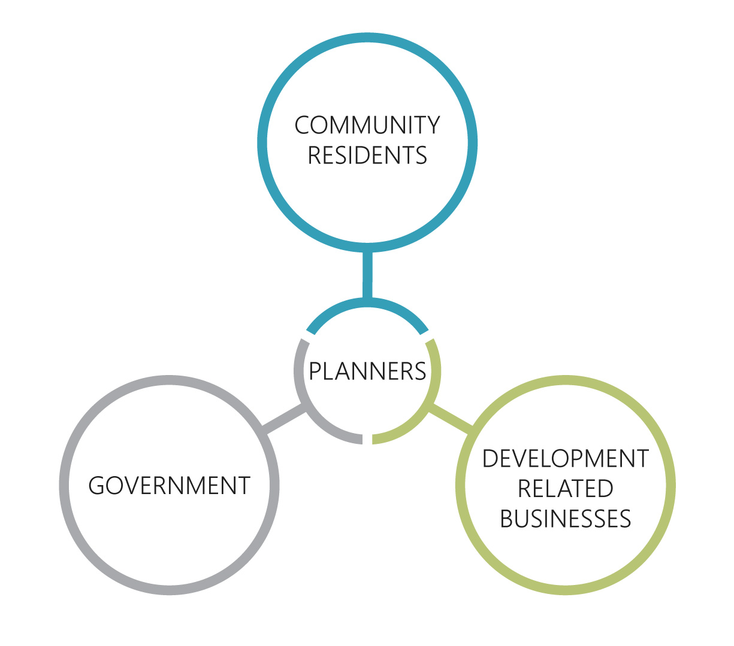
Stake Holders

Slide 23
Role Play
Time: 12 Minutes
Each group will have a unique challenge and unique roles.
It’s your job to work together to assumer these roles and devise unique solutions for your community. Be creative and good luck!

Slide 24
Role Play
Guiding Questions:
What kind of need is there for that kind of project?
What motivation do you have given your role play card?
How will this benefit the community?
How does this solution impact other stake holders?
How does your community handle this kind of situation?

Slide 25
FUTURE IN THE PLANNING PROCESS

Slide 26
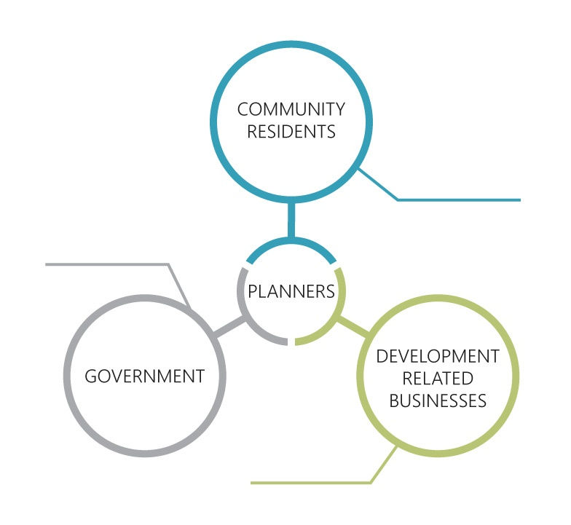
Spheres of Stake Holders
Elected officials – City council, County commission.
Government Departments (Public Works, Utilities, Transportation, Wastewater, Stormwater, Parks and Rec, etc.)
State and Federal agencies
Individuals
Business owners
Neighborhood Associations
Non-profit organizations (environmental, social service, healthcare, etc.)
Churches
Schools
Developers
Large property owners
Builders
Developers attorneys
Private planning or development consultants

Slide 27
Planning Process
Pre-application consultation with staff and community management
Applicant submits complete application
Application circulated by staff
Preliminary report to Community Council
Notes:
Pre-application consultation with staff and community management
Applicant submits complete application
Application circulated by staff
Preliminary report to Community Council

Slide 28
Planning Process
Community consultation
Response to applicant by staff
Application revision and resubmission by applicant
Recirculation, consultation, revisions, finalization and staff report
Notes:
Community consultation
Response to applicant by staff
Application revision and resubmission by applicant
Recirculation, consultation, revisions, finalization and staff report

Slide 29
Planning Process
Public meeting at Community Council
Decision by City Council
Opportunity for appeal to Municipal Board
Official Plan amendment/By-law effect
Notes:
Public meeting at Community Council
Decision by City Council
Opportunity for appeal to Municipal Board
Official Plan amendment/By-law effect

Slide 30
Jobs in Planning
There are many types of jobs within the planning profession.
Examples:
Land Use Planner: Land Use Planners create programs and plans for land development and usage.
Transportation Planner: A transportation planner is someone who works alongside government agencies to select and develop plans to organize transportation options.
Economic Development Planner: An economic development planner assists in supporting the City's economic development program and redevelopment activities.
Natural Resources Planner: They are responsible for planning related to the environmental impact of city infrastructure and city policies. They also work to develop city codes and ordinances required to comply with State requirements (BMAP and TMDL).

Slide 31
QUESTIONS?

Slide 32
v
THANK YOU!
Name
Title
Email
Website (optional)

Slide 33
Praesent dapibus, neque id cursus faucibus, tortor neque egestas augue, eu vulputate magna eros eu erat. Aliquam erat volutpat. Nam dui mi, tincidunt quis, accumsan porttitor, facilisis luctus, metus.
Phasellus ultrices nulla quis nibh. Quisque a lectus. Donec consectetuer ligula vulputate sem tristique cursus. Nam nulla quam, gravida non, commodo a, sodales sit amet, nisi.

