Slide 1


v
Name
Title

Slide 2

Get to Know a Planner
General and very high-level description of what you do as a planner:
  Project types you have been involved in (possibly avoid mentioning any specific projects that could be politically charged discussion points)
  Types of people you interact with on a daily basis
  What you enjoy best about being a planner
What attracted you to planning?
How did you get into planning?
YOUR
PHOTO
HERE
YOUR
PHOTO
HERE

Slide 3
RULES OF
THE ROAD
Expectations
  Ask questions.
  Pay attention.
  Participate.
  Be respectful and professional towards other students.
  Be creative!
  Have fun!

Slide 4
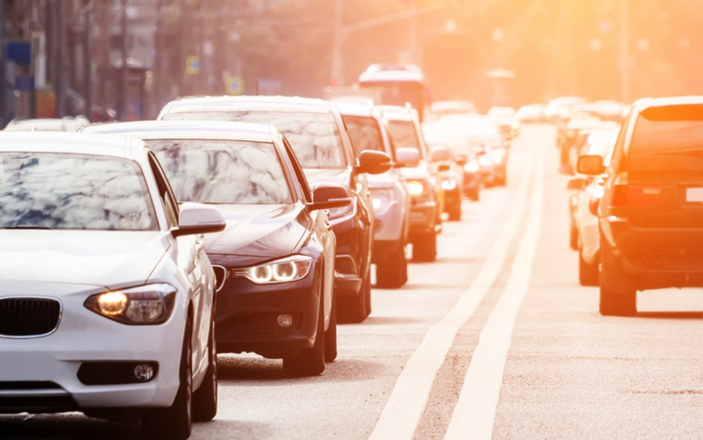
THE PROBLEM:
COMMUTE TIMES
Please take out your
As the Planner Sees It: Role Play packets.

Slide 5
ROLE PLAY: OBJECTIVES
Evaluate the problem and determine if any action is necessary.
Set some goals based on your evaluation.
Propose solutions to the problem.
Make a decision about what the city will do moving forward.
Write-up your plan!

Slide 6
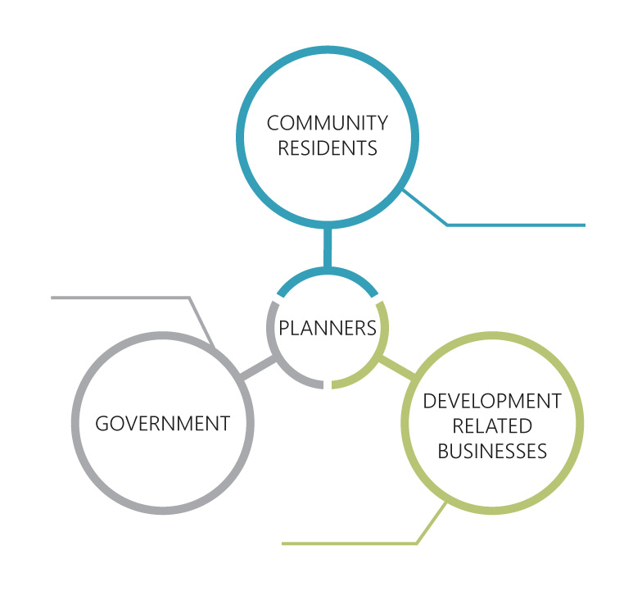
STAKE HOLDERS
Individuals
Business owners
Neighborhood Associations
Non-profit organizations (environmental, social service, healthcare, etc.)
Churches
Schools
Elected officials – City council, County commission.
Government Departments (Public Works, Utilities, Transportation, Wastewater, Stormwater, Parks and Rec, etc.)
State and Federal agencies
Developers
Large property owners
Builders
Developers attorneys
Private planning or development consultants

Slide 7
PLANNERS
Middle of all three spheres: Community Residents, Government, and Development Related Businesses.
Facilitate communication between the three groups.
Help residents develop and refine the community vision.
The vision of the community is constantly changing, so planners must be nimble and continuously update and refine plans.
Help government develop the policy and code to implement the vision.
Work with developers to help them understand the policy and code to improve projects, so they match the community vision.

Slide 8
COMMUNITY RESIDENTS
Set the vision for the community.
Let the planners know what they want for their community.

Slide 9
GOVERNMENT
Responsible for implementing the vision of the residents.
Local government controls the adopted policy, code, and provides the budget.
Creative governments can succeed at implementing a vision with a limited budget.

Slide 10
DEVELOPMENT RELATED
BUSINESSES
These are the players who are on the ground building and putting the vision in place through development and redevelopment projects.

Slide 11


PLANNING PROCESS

Slide 12

Step 1:
COLLECT DATA
Good planning solutions are based on data
Data comes in many types:
  Maps
  Demographic Data
  Surveys

Slide 13
LAND USE MAPS
These maps are used in planning to help prevent things like urban sprawl.
How do you think maps are used in community planning?
Decide where businesses go
Decide what businesses go where
Decide where nature preserves and parks go
Plan transportation
Decide where public services can go

Slide 14

Land Use
Maps
POPUATION
DENSITY MAPS
How do you think maps are used in community planning?
Decide where businesses go
Decide what businesses go where
Decide where nature preserves and parks go
Plan transportation
Decide where public services can go
These maps show concentrations of population density that can aid in decisions about infrastructure and things like highways to connect residents with areas of higher job concentration.

Slide 15
Land Use
Maps
AERIAL VIEW
MAPS
How do you think maps are used in community planning?
Decide where businesses go
Decide what businesses go where
Decide where nature preserves and parks go
Plan transportation
Decide where public services can go
These maps help planners determine what’s on the ground and the surrounding uses.

Slide 16
Land Use
Maps
MODES OF TRANSPORTION
MAPS
How do you think maps are used in community planning?
Decide where businesses go
Decide what businesses go where
Decide where nature preserves and parks go
Plan transportation
Decide where public services can go
These maps help planners see what kinds of transportation are available in different areas.

Slide 17
Land Use
Maps
VACANT PARCEL
MAPS
How do you think maps are used in community planning?
Decide where businesses go
Decide what businesses go where
Decide where nature preserves and parks go
Plan transportation
Decide where public services can go
These maps help planners see what kinds of transportation are available in different areas.

Slide 18

Land Use
Maps
How do you think maps are used in community planning?
Decide where businesses go
Decide what businesses go where
Decide where nature preserves and parks go
Plan transportation
Decide where public services can go
STREETS & RAIL NETWORK MAPS
These maps help planners see what kinds of transportation are available in different areas.

Slide 19
Land Use
Maps
CONGESTED ROADWAYS
MAPS
How do you think maps are used in community planning?
Decide where businesses go
Decide what businesses go where
Decide where nature preserves and parks go
Plan transportation
Decide where public services can go
These maps rate the health of roadways according to how congested that they become.
Green – Healthy, low congestion
Yellow – Less healthy, congested
Red – Unhealthy, very congested

Slide 20
Land Use
Maps
PROBLEM INTERSECTIONS MAPS
How do you think maps are used in community planning?
Decide where businesses go
Decide what businesses go where
Decide where nature preserves and parks go
Plan transportation
Decide where public services can go
These depict intersections in the roadways that are in need of improvement. Those needing improvement are usually represented with a Red dot.

Slide 21

Common demographic data we use is population projections, ages, ethnicity, income, travel patterns, employment in specific industries.
Population projections are the most important as they help us plan where and how communities will grow (or shrink) over the next decade or two. Help us plan for where to locate homes, schools, parks, roads, transit, etc.
Land Use
Maps
How do you think maps are used in community planning?
Decide where businesses go
Decide what businesses go where
Decide where nature preserves and parks go
Plan transportation
Decide where public services can go
DEMOGRAPHIC DATA

Slide 22

There are many types of surveys and formats for their distribution. They pose simple questions to gather data that can be used to indicate needs, opinions, and even evaluate. They can be used, for example, in deciding whether a community is willing to finance a project.
Land Use
Maps
How do you think maps are used in community planning?
Decide where businesses go
Decide what businesses go where
Decide where nature preserves and parks go
Plan transportation
Decide where public services can go
SURVEYS

Slide 23


PLANNING PROCESS
Step 1:
COLLECT DATA
Step 2:
ANALYZE

Slide 24
ANALYZE
Analyze the data that you’ve collected.
Collaborate with different stakeholders to find out what the data are telling you about the problem
Use the maps and other data available to figure what the problem is and start getting an idea of what to do about it.

Slide 25

PLANNING PROCESS
Step 1:
COLLECT DATA
Step 2:
ANALYZE
Step 3:
SET GOALS

Slide 26
SET GOALS
Based on your analysis and understanding of the problem, think of goals (2-3).
Talk among the other stakeholders (using your role play cards as a guide) to develop them.
What do you want to happen?
What are some milestones towards that vision?

Slide 27

PLANNING PROCESS
Step 1:
COLLECT DATA
Step 2:
ANALYZE
Step 3:
SET GOALS
Step 4:
GENERATE CHOICES

Slide 28
GENERATE CHOICES
Talk among the other stakeholders (using your role play cards as a guide) to develop some choices based on your goals (1-3).
You all have different views and objectives so it’s okay to have different options at this point.
Be creative! In this role play, you are not limited by current technologies or practicality but try and have at least one option that is doable.

Slide 29

PLANNING PROCESS
Step 1:
COLLECT DATA
Step 2:
ANALYZE
Step 3:
SET GOALS
Step 4:
GENERATE CHOICES
Step 5:
MAKE A WRITTEN PLAN

Slide 30

MAKE A WRITTEN PLAN
List the data you used
Describe what your analysis told you
Write down your goals
Describe the choice your group made and why
Include a graphic illustration of your solution (quick sketch)

Slide 31

PLANNING PROCESS
Step 1:
COLLECT DATA
Step 2:
ANALYZE
Step 3:
SET GOALS
Step 4:
GENERATE CHOICES
Step 5:
MAKE A WRITTEN PLAN
Step 6:
THINK IT THROUGH

Slide 32
THINK IT THROUGH
How long will it take?
Can it be done all at once or should there be phases?
What kinds of information might you need?
  $$$$$
  Who will build it?
  Who will manage it?
  Is it legal?
What kind of follow up might be involved?

Slide 33
PLANNING PROCESS
Step 1:
COLLECT DATA
Step 2:
ANALYZE
Step 3:
SET GOALS
Step 4:
GENERATE CHOICES
Step 5:
MAKE A WRITTEN PLAN
Step 6:
THINK IT THROUGH

Slide 34

CONGRATULATIONS!
Your new project is approved and being built.
The community loves your solution and can’t wait to get this traffic moving!

Slide 35
v
POP QUIZ
Notes:
**Optional Closing Discussion**
How many phases or steps are there to the Planning Process we used today?
What did we do with our land use map? What about with our other maps?
What are some things that we thought about while planning our solution to commute times?
What did you like best about today?
What did you learn that you will tell your family or friends?
Would anyone like to be a planner when they finish school? Why or why not?

Slide 36

QUESTIONS?

Slide 37
v
THANK YOU!
Name
Title
Email
Website (optional)

